Slide 1
Chi-Square Test

Slide 2
Chi-Square (χ²) Test
Used to determine if there is a significant difference between the expected and observed data
Null hypothesis: There is NO statistically significant difference between expected & observed data
Any differences are due to CHANCE alone

Slide 3
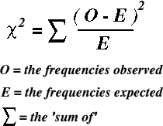
Chi-Square (χ²) Formula

Slide 4
How to use the Chi-Square Test
Determine null hypothesis
All frequencies are equal –OR– Specific frequencies given already
Use formula to calculate χ² value:
n = # of categories, e = expected, o = observed
Find critical value using table (Use p=0.05).
degrees of freedom (df) = n – 1
If χ² < Critical Value, then ACCEPT null hypothesis. Differences in data are due to chance alone.
If χ² > Critical Value, REJECT the null hypothesis: Differences in data are NOT due to chance alone!

Slide 5
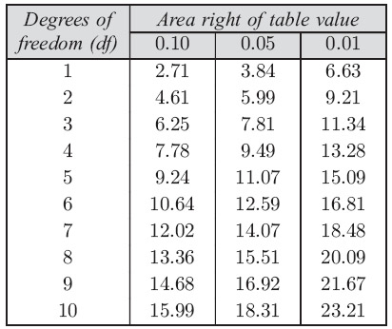

Slide 6
Sample Problem
You buy a package of M&Ms from the factory store and find the following: 20 brown, 20 blue, 20 orange, 20 green, and 20 yellow M&Ms.
According to the M&M website, each package of candy should have 13% brown, 24% blue, 20% orange, 16% green, 13% red, and 14% yellow M&Ms.
You realize you are missing Red M&M’s in your package! Is this acceptable, or did something happen in the factory during the packaging process?
Use the Chi-Square Test to answer this question.

