Slide 1
Engineering Design

Slide 2
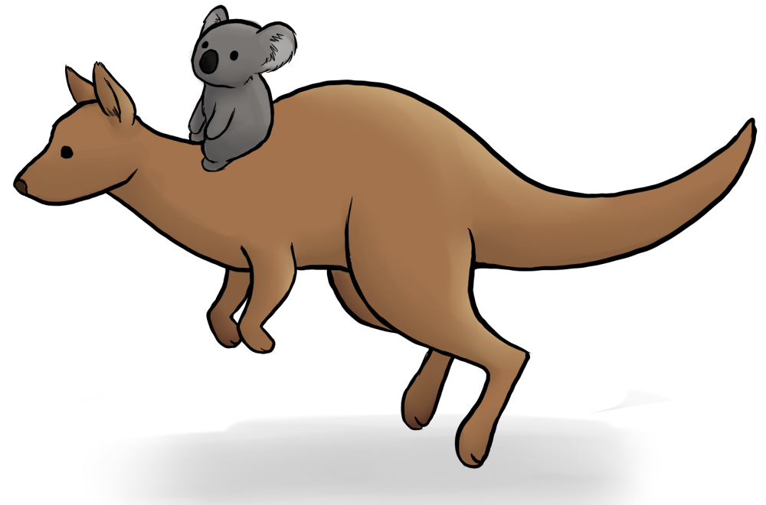
Kangaroos and Koalas
Using the person at the opposite corner of the table from you, decide who will be the kangaroo and who will be the koala

Slide 3
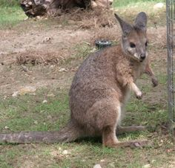
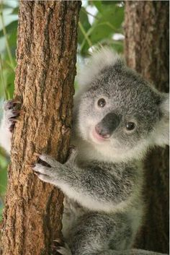
Koalas and Kangaroos
Discuss inference with your partner and write a definition without using your notes

Slide 4
Objectives
SPI 3210.T/E.2 Evaluate a protocol to determine the degree to which an engineering design process was successfully applied.
SPI 3210.T/E.3 Evaluate the overall benefit to cost ratio of a new technology.
SPI 3210.T/E.4 Use design principles to determine how a new technology will improve the quality of life for an intended audience.

Slide 5
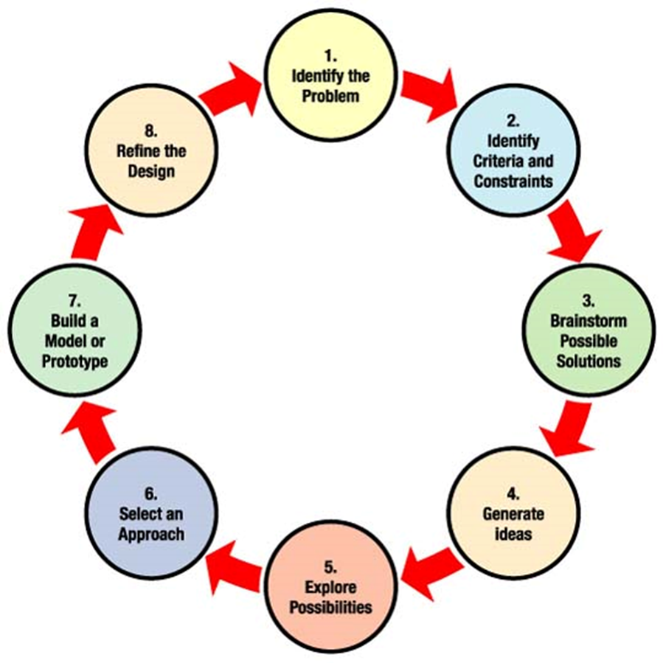
The engineering design Process
Similar to the scientific method but not the same thing

Slide 7
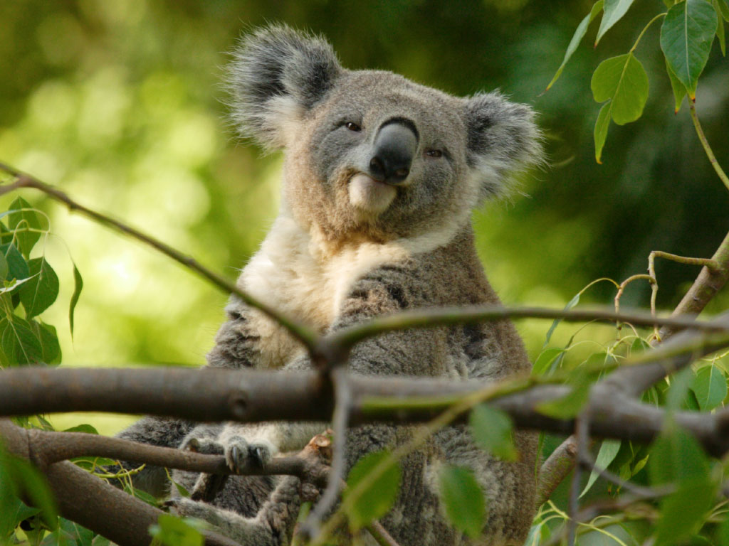
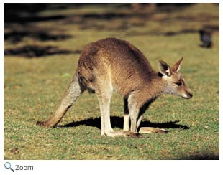
Kangaroos and Koalas
Kangaroos: Explain the first four steps of the Engineering Design Process
Koalas: Explain the last four steps of the Engineering Design process

Slide 8
Observing the results of the process
In the following video, make a list of all of the types of sports shown and the devices that the Paralympic athletes use
http://www.pbslearningmedia.org/resource/adptech12.sci.engin.design.mqutech/titanium-chairs-and-cheetah-legs/?utm_source=lmnews&utm_medium=email&utm_campaign=mktg_2016

Slide 9
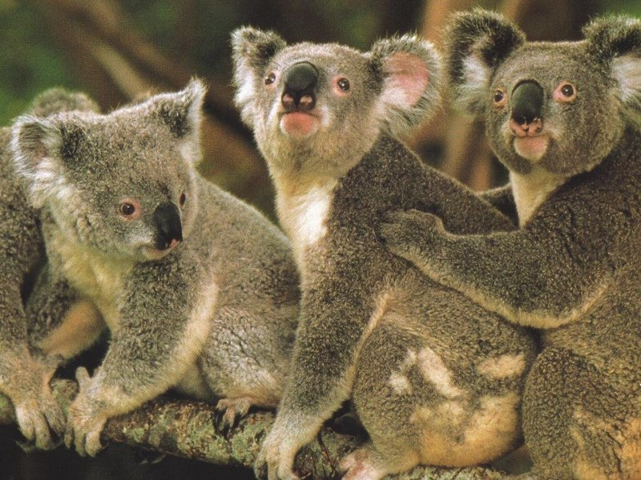
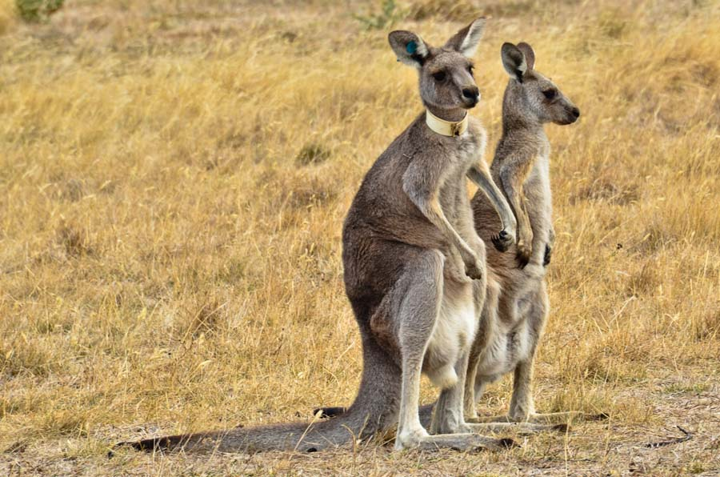
Kangaroos and Koalas
Compare your video notes with the others at your table

Slide 10
Discussion Questions
Each table will be assigned a sport as we watch the video again. For your sport, write down the problem, as well as the criteria for constraints on the solution.
What pitfalls do you think they might have run into in designing these prosthetics?
What types of cost issues do you think they may have encountered?
How does this information relate to the engineering design process?

Slide 11
Practice questions
Answer the practice questions . Write your answers in your lab book.

Slide 12
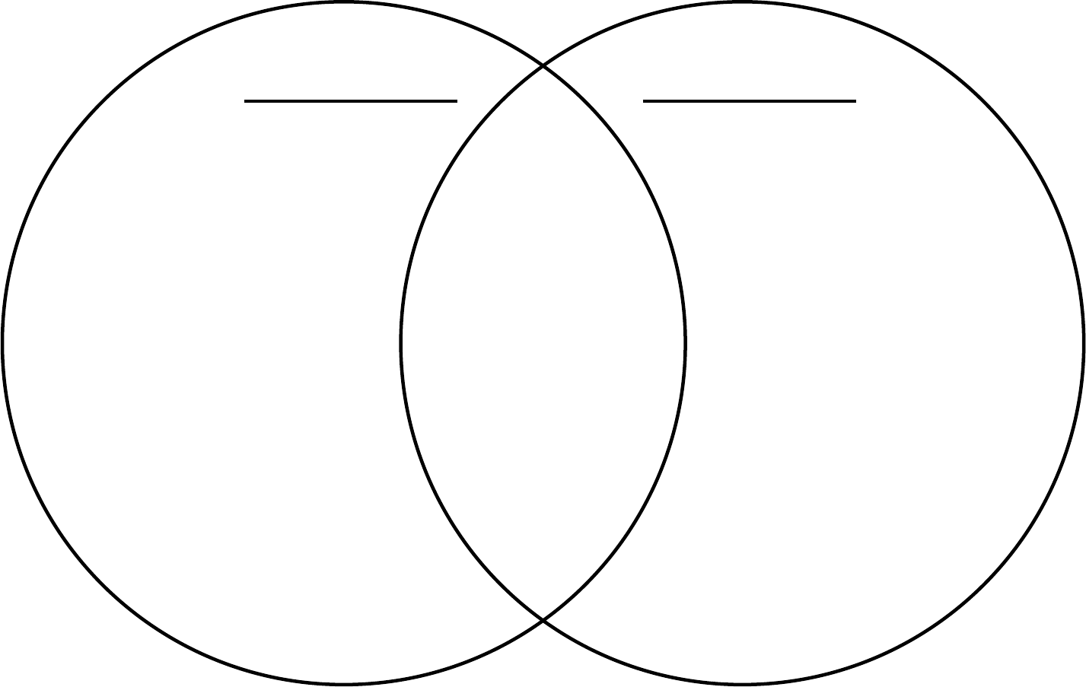
Taking it a step further
Draw a Venn diagram that compares the scientific method to the engineering design process. How are they similar? How are they different?

